Slide 1
CS4335: Design and Analysis of Algorithms
Lecturers:
  Prof. Lusheng Wang
    Dept of CS, AC1-G7363, T: 9820, E: cswangl@
  Prof. Qingfu Zhang
    Dept. of CS, AC1-G7353, T: 8632, E: qingfu.zhang@
Course web site: canvas
Page <number>
115/11/07
CS4335 Design and Analysis of Algorithms /WANG Lusheng

Slide 2
Text Book:
    J. Kleinberg and E. Tardos, Algorithm design, Addison-Wesley, 2013.
    We will add more materials in the handout.
References:
    T. H. Cormen, C. E. Leiserson, R. L. Rivest, Introduction to Algorithms, The MIT Press, 2009.
    M.R. Garry and D. S. Johnson, Computers and intractability, a guide to the theory of NP-completeness, W.H. Freeman and company, 1979 one of the most famous books in CS.
Page <number>
115/11/07
CS4335 Design and Analysis of Algorithms /WANG Lusheng

Slide 3
Algorithms
Any well-defined computational procedure that takes some value, or set of values, as input and produces some value, or set of values, as output.
A sequence of computational steps that transform the input into output.
A sequence of computational steps for solving a well-specified computational problem.
Page <number>
115/11/07
CS4335 Design and Analysis of Algorithms /WANG Lusheng

Slide 4
Example of well-specified problem: Sorting
Input: a sequence of numbers: 1, 100, 8, 25, 11, 9, 2, 1, 200.
Output: a sorted (increasing order or decreasing order) sequence of numbers
1, 2, 8, 9, 11, 25, 100, 200.
Another example:
Create web page that contains a list of papers using HTML.
-everybody can do it.
Do not need to design computational steps.
Page <number>
115/11/07
CS4335 Design and Analysis of Algorithms /WANG Lusheng

Slide 5
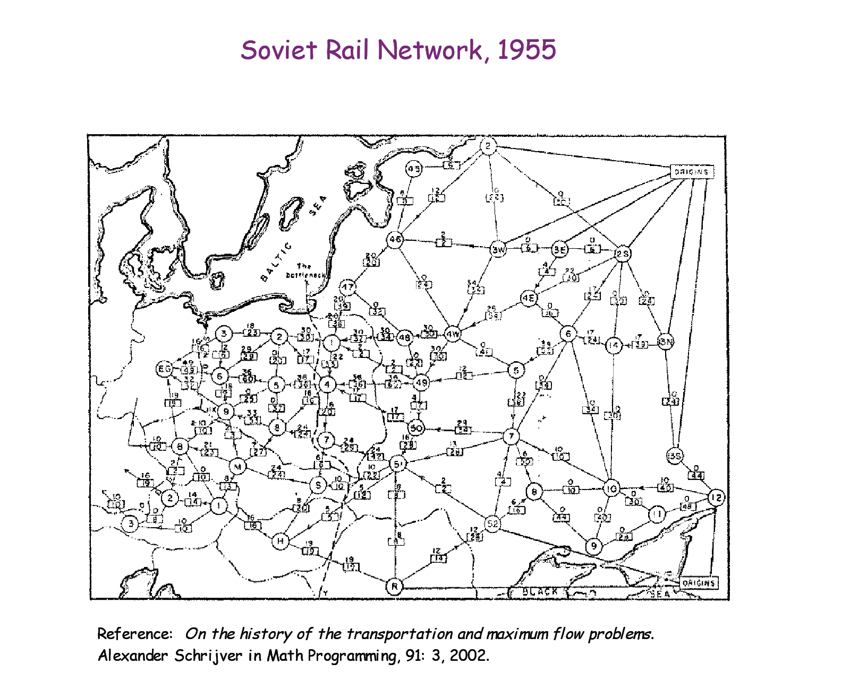
B
A
Find a shortest path from station A to station B.
-need serious thinking to get a correct algorithm.
Page <number>
115/11/07
CS4335 Design and Analysis of Algorithms /WANG Lusheng

Slide 6
GPS Navigation System
Given an electronic map (stored on a cellphone), the position of your car (provided by GPS), and the destination,
the system can tell you the way to go to the destination.
Tell you tern left or right 40 meters before according to the shortest path.
If you did not follow the direction, re-calculate the shortest path.
Page <number>
115/11/07
CS4335 Design and Analysis of Algorithms /WANG Lusheng

Slide 7
Dijkstra’s Algorithm: (Recall)
Dijkstra’s algorithm assumes that w(e)≥0 for each e in the graph.
maintain a set S of vertices such that
  Every vertex v ∈S, d[v]=δ(s, v), i.e., the shortest-path from s to v has been found. (Intial values: S=empty, d[s]=0 and d[v]=∝)
(a) select the vertex u∈V-S such that
d[u]=min {d[x]|x ∈V-S}. Set S=S∪{u}
(b) for each node v adjacent to u do RELAX(u, v, w).
Repeat step (a) and (b) until S=V.
Page <number>
115/11/07
CS4335 Design and Analysis of Algorithms /WANG Lusheng

Slide 8
Descriptions of Algorithms
Flow charts
Pseudo-codes
Natural languages
Computer Programs
The purpose:
Allow a well-trained programmer to write a program to solve the computational problem.
Any body who can talk about algorithm MUST have basic programming skills
Also CS3334: Data structures.
Page <number>
115/11/07
CS4335 Design and Analysis of Algorithms /WANG Lusheng

Slide 9
What We Cover:
Some classic algorithms in various domains
  Graph algorithms
    Euler path, shortest path, minimum spanning trees, maximum flow, Hamilton Cycle, traveling salesman problem,
  String Algorithms
    Exact string matching, Approximate string matching, Applications in web searching engines
  Scheduling problems
  Computational Geometry
Techniques for designing efficient algorithms
  divide-and-conquer approach, greedy approach, dynamic programming, linear programming.
Page <number>
115/11/07
CS4335 Design and Analysis of Algorithms /WANG Lusheng

Slide 10
What We Cover(continued):
Introduction to computational complexity
  NP-complete problems
Approximation algorithms
  Vertex cover
  Steiner trees
  Traveling salesman problem
Page <number>
115/11/07
CS4335 Design and Analysis of Algorithms /WANG Lusheng

Slide 11
Why You have to take this course
Apply learned techniques to solve various problems
Have a sense of complexities of various problems in different domains
  Find excuses if you cannot solve a problem.
College graduates vs. University graduates
Supervisor vs. low level working force
Page <number>
115/11/07
CS4335 Design and Analysis of Algorithms /Shuai Cheng Li

Slide 12
Why You have to take this course
You can apply learned techniques to solve various problems
Have a sense of complexities of various problems in different domains
College graduates vs. University graduates
Supervisor v.s. low level working force
Page <number>
115/11/07
CS4335 Design and Analysis of Algorithms /WANG Lusheng

Slide 13
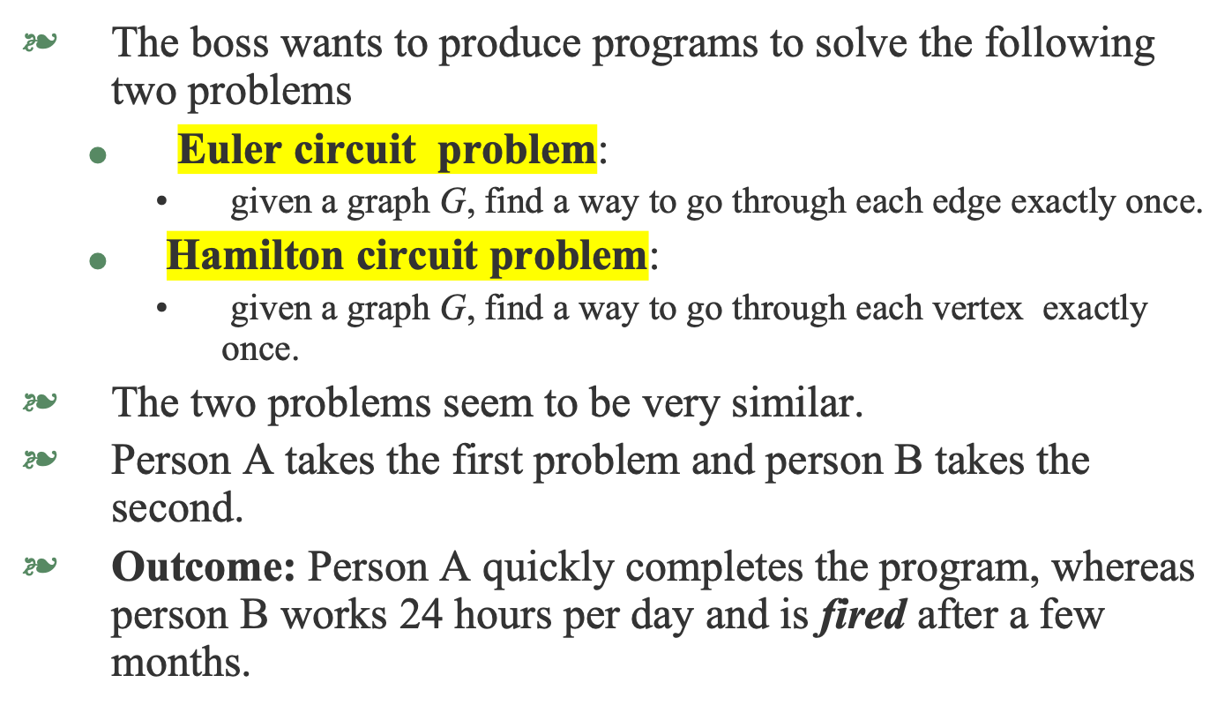

Page <number>
115/11/07
CS4335 Design and Analysis of Algorithms /WANG Lusheng

Slide 14
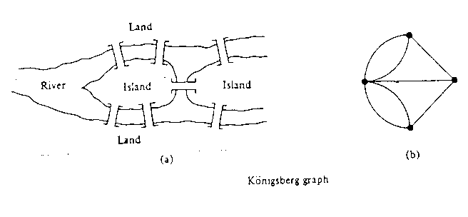
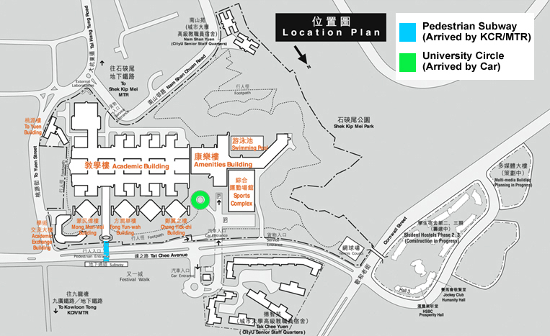
Euler Circuit: The original Konigsberg bridge
Page <number>
115/11/07
CS4335 Design and Analysis of Algorithms /WANG Lusheng

Slide 15
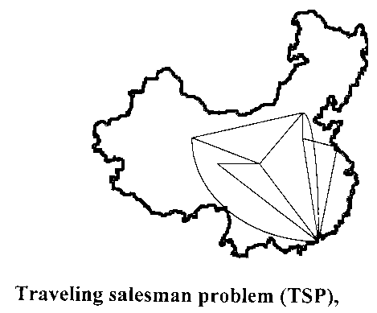
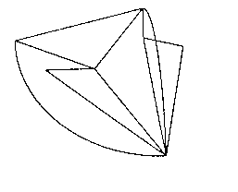
Hamilton Circuit
Page <number>
115/11/07
CS4335 Design and Analysis of Algorithms /WANG Lusheng

Slide 16
Why?
Explanation:
  Euler circuit problem can be easily solved in polynomial time.
  Hamilton circuit problem is proved to be NP-hard.
  So far, no body in the world can give a polynomial time algorithm for a NP-hard problem.
  Conjecture: there does not exist polynomial time algorithm for this problem.
Page <number>
115/11/07
CS4335 Design and Analysis of Algorithms /WANG Lusheng

Slide 17
Evaluation of the Course
Course work: 30%
    4 points for each of the two assignments
    12 points for midterm exam (week 7)
    0.5 point for each in-lecture exercise (from weeks 2 to 11)
    0.5 point for each tutorial (for tutorials 2 to 11)
final exam: 70%
Page <number>
115/11/07
CS4335 Design and Analysis of Algorithms /WANG Lusheng

Slide 18
Evaluation of the Course (OBTL)
No.CILOs .
prove the correctness and analyze the running time of the basic algorithms for those classic problems in various domains;
apply the algorithms and design techniques to solve problems;
analyze the complexities of various problems in different domains.
For CILO 1- CILO 3, we have assignments to evaluate.
You have to pass all CILOs in order to pass the course.
Page <number>
115/11/07
CS4335 Design and Analysis of Algorithms /WANG Lusheng

Slide 19
The Process of Design an Algorithm
Formulating the problem
  with enough mathematical precision, we can ask a concrete question
  start to solve it.
Design the algorithm
  list the “precise” steps. (an expert can translate the algorithm into a computer program.)
Analyze the algorithm
  prove that it is correct
  establish the efficiency
    the running time or sometimes, space complexity
Page <number>
115/11/07
CS4335 Design and Analysis of Algorithms /WANG Lusheng

Slide 20
How to Teach
Contents are divided into four classes
1. Basic part -- every body must understand in order to pass
2. Moderate part -- most of students should understand.
Aim at B or above.
3. Hard part -- used to distinguish students.
Aim at A or above.
4. Fun and Challenging part -- useful knowledge
that will not be tested.
Page <number>
115/11/07
CS4335 Design and Analysis of Algorithms /WANG Lusheng

Slide 21
How to Learn
1. Attend every lecture (2 hours per week) and
tutorial (1 hour per week)
2. Try to go with me when I am talking
3. Ask questions immediately
4. Try to fix all problems during the 1 hour tutorial
5. Ask others.
Page <number>
115/11/07
CS4335 Design and Analysis of Algorithms /WANG Lusheng

Slide 22
Terminologies
A Graph G=(V,E): V---set of vertices and E--set of edges.
Path in G: sequence v₁, v₂, ..., v_{k} of vertices in V such that (v_{i}, v_{i+1}) is in E.
  v_{i} and v_{j} could be the same
Circuit: A path v₁, v₂, ..., v_{k} such that v₁ =v_{k}
.
Degree of a vertex: number of edges incident to the vertex.
Page <number>
115/11/07
CS4335 Design and Analysis of Algorithms /WANG Lusheng

Slide 23
Euler Circuit Problem
  Input: a connected graph G=(V, E)
  Problem: is there a circuit in G that uses each edge exactly once.
  Note: G can have multiple edges, .i.e., two or more edges connect vertices u and v.
Page <number>
115/11/07
CS4335 Design and Analysis of Algorithms /WANG Lusheng

Slide 24
Euler Circuit problem (continued)
solved by Leonhard Euler [pronounced OIL-er] (1736)
The first problem solved by using graph theory
A graph is constructed to describe the town.
Page <number>
115/11/07
CS4335 Design and Analysis of Algorithms /WANG Lusheng

Slide 25
The original Konigsberg bridge (Figure 1)
Page <number>
115/11/07
CS4335 Design and Analysis of Algorithms /WANG Lusheng

Slide 26
Theorem for Euler circuit
Theorem 1 (Euler’s Theorem) A connected graph has an Euler circuit if and only if all the vertices in the graph have even degrees.
Proof: if an Euler circuit exists, then the degree of each node is even.
Going through the circuit, each time a vertex is visited, the degree is increased by 2. Thus, the degree of each vertex is even.
Page <number>
115/11/07
CS4335 Design and Analysis of Algorithms /WANG Lusheng

Slide 27
Example 1:
C1:abca, C2:bdefb, =>C3:abdefbca. C4:eijhcge. C3+C4=>abdeijhcgefbca
1
4
d
5
a
b
b
7
6
e
3
2
f
2
d
c
1
3
after merge
a
b
11
10
2
d
3
e
1
13
12
f
a
b
5
4
c
e
9
7
6
f
e
8
4
c
7
g
c
13
h
i
12
g
8
11
6
5
j
h
10
i
9
j
Page <number>
115/11/07
CS4335 Design and Analysis of Algorithms /WANG Lusheng

Slide 28
An efficient algorithm for Euler circuit
1. Starting with any vertex u in G, take an unused edge (u,v) (if there is any) incident to u
2. Do Step 1 for v and continue the process until v has no unused edge. (a circuit C is obtained)
3. If every node in C has no unused edge, stop.
4. Otherwise, select a vertex, say, u in C, with some
unused edge incident to u and do Steps 1 and 2 until another circuit is obtained.
5. Merge the two circuits obtained to form one circuit
6. Goto Step 3.
Page <number>
115/11/07
CS4335 Design and Analysis of Algorithms /WANG Lusheng

Slide 29
Proof of Theorem 1: if the degree of every node is even, then there is an Euler circuit.
We give a way to find an Euler circuit for a graph in which every vertex has an even degree.
• Since each node v has even degree, when we first enter v, there is an unused edge that can be used to get out v.
• The only exception is when v is a starting node.
• Then we get a circuit (may not contain all edges in G)
• If every node in the circuit has no unused edge, all the
edges in G have been used since G is connected.
• Otherwise, we can construct another circuit, merge
the two circuits and get a larger circuit.
• In this way, every edge in G can be used.
Page <number>
115/11/07
CS4335 Design and Analysis of Algorithms /WANG Lusheng

Slide 30
Example 2:
a
b
First circuit: a-b-d-c-a
Second circuit: d-f-e-c-d.
Merge: a-b-d-f-e-c-d-c-a.
3rd circuit: e-g-h-e
Merge: a-b-d-f-e-g-h-e-c-d-c-a
c
d
f
e
Note: There are multiple edges.
g
h
Page <number>
115/11/07
CS4335 Design and Analysis of Algorithms /WANG Lusheng

Slide 31
Representations of Graphs (Fun Part)
Two standard ways
  Adjacency-list representation
    Space required O(|E|)
  Adjacency-matrix representation
    Space required O(n²).
Depending on problems, both representations are useful.
Page <number>
115/11/07
CS4335 Design and Analysis of Algorithms /WANG Lusheng

Slide 32
Adjacency-list representation
Let G=(V, E) be a graph.
  V– set of nodes (vertices)
  E– set of edges.
For each u∈V, the adjacency list Adj[u] contains all nodes in V that are adjacent to u.
1
2
5
/
1
2
2
1
5
3
4
/
3
3
2
4
/
4
2
5
3
/
5
4
5
4
1
2
/
(a)
(b)
Page <number>
115/11/07
CS4335 Design and Analysis of Algorithms /WANG Lusheng

Slide 33
Adjacency-list representation for directed graph
1
2
4
/
1
2
3
2
5
/
3
6
5
/
4
2
/
4
5
6
5
4
/
6
6
/
(a)
(b)
Page <number>
115/11/07
CS4335 Design and Analysis of Algorithms /WANG Lusheng

Slide 34
Adjacency-matrix representation
Assume that the nodes are numbered 1, 2, …, n.
The adjacency-matrix consists of a |V|×|V| matrix A=(a_{ij}) such that
a_{ij}= 1 if (i,j) ∈E, otherwise a_{ij}= 0.
1 2 3 4 5
1
2
3
4
5
0 1 0 0 1
1 0 1 1 1
0 1 0 1 0
0 1 1 0 1
1 1 0 1 0
1
2
3
5
4
(a)
(c)
Page <number>
115/11/07
CS4335 Design and Analysis of Algorithms /WANG Lusheng

Slide 35
Adjacency-matrix representation for directed graph
It is NOT symmetric.
1 2 3 4 5 6
1
2
3
1
2
3
4
5
6
0 1 0 1 0 0
0 0 0 0 1 0
0 0 0 0 1 1
0 1 0 0 0 0
0 0 0 1 0 0
0 0 0 0 0 1
4
5
6
(a)
(c)
Page <number>
115/11/07
CS4335 Design and Analysis of Algorithms /WANG Lusheng

Slide 36
Implementation of Euler circuit algorithm (Not required)
Data structures:
  Adjacency-list representation
  Each node in V has an adjacency list
  Also, we have two lists to store the circuits
    One for the circuit produced in Steps 1-2.
    One for the circuit produced in Step 4
In Step 1: when we take an unused edge (u, v), this edge is deleted from the adjacency-list of nodes u and v.
Page <number>
115/11/07
CS4335 Design and Analysis of Algorithms /WANG Lusheng

Slide 37
Implementation of Euler circuit algorithm
  In Step 2: if the adjacency list of v is empty, v has no unused edge.
  Testing whether adjacency-list v is empty.
  A circuit (may not contain all edges) is obtained if the above condition is true.
  In Step 3: if each of the nodes in C, the adjacency-list is empty, stop.
  In step 4: if some adjacency-list is not empty, use it in step 4.
Page <number>
115/11/07
CS4335 Design and Analysis of Algorithms /WANG Lusheng

Slide 38
Time complexity (Fun Part)
  If it takes O(|V|) time to add an edge to a circuit, then the time complexity is O(|E||V|).
  This can be done by using an adjacency list.
  The implementation is tricky
  Even O(|V||E|) algorithm is not trivial.
  Do not be disappointed if you do not completely understand the implementation
  The best algorithm takes O(|E|) time.
  Euler Circuit: A complete example for Designing Algorithms.
  -formulation, design algorithm, analysis.
Page <number>
115/11/07
CS4335 Design and Analysis of Algorithms /WANG Lusheng

Slide 39
Application 1:
  In a map, two countries may share a common border. Given a map, we want to know if it is possible to find a tour starting from a country, going across each shared border once and come back to the starting country.
A
B
A
B
D
C
D
C
Page <number>
115/11/07
CS4335 Design and Analysis of Algorithms /WANG Lusheng

Slide 40

Application 2:
  Formulating a graph problem: Given a map containing Guizhou, Hunan, Jiangxi, Fujian, Guangxi, Guangdong, construct a graph such that if two provinces share some common boarder, then there is an edge connecting the two corresponding vertices.
  If we want to find a tour to visit each province once, then we need to find a Hamilton circuit in the graph.
Page <number>
115/11/07
CS4335 Design and Analysis of Algorithms /WANG Lusheng

Slide 41
Challenge Problem : (only for those who are interested)
  Prove that given a graph G=(V, E), one can always add some edges to the graph such that the new graph (multiple edges are allowed) has an Euler circuit.
  Design an algorithm to add minimum number of edges to an input graph such that the resulting graph has an Euler circuit.
  Prove the correctness of your algorithm.
Page <number>
115/11/07
CS4335 Design and Analysis of Algorithms /WANG Lusheng

Slide 42
Summary of Euler Circuit Algorithm
Design a good algorithm needs two parts
    Theorem, high level part
    Implementation: low level part. Data structures are important.
    Our course emphasizes the first part and demonstrates the second part whenever possible.
    We will not emphasize too much about data structures.
Data Structures Needed: Heap and disjoint set
Page <number>
115/11/07
CS4335 Design and Analysis of Algorithms /WANG Lusheng

